Slide 1
Deploying an E-commerce Apparel App on EKS

Slide 2
What is Microservice
A microservice is a small, independent part of a larger application, each responsible for a specific task. Instead of building one big app, you break it down into smaller services that work together. Each service can be updated, deployed, and scaled on its own.
For example, in an online store, there could be one microservice for handling user accounts, another for processing orders, and another for payments.

Slide 3
EKS(ELASTIC KUBERNETES SERVICE)
Amazon EKS (Elastic Kubernetes Service) is a service provided by Amazon Web Services (AWS) that makes it easier to run and manage Kubernetes on AWS.
EKS helps by handling the complex setup and management of Kubernetes clusters (groups of computers that run Kubernetes)
Kubernetes is a system that helps you manage and run applications in containers across many computers.
It groups containers together into "pods" (a pod is a small unit where one or more containers run together).
It can automatically increase or decrease the number of containers (or pods) depending on the demand, so your app runs smoothly without manual intervention.
Imagine you're running a website. The website needs different parts like a front-end, back-end, and database. Instead of running all these parts on a single server, Kubernetes can spread them across multiple machines, keep them running, and ensure the website stays up even if something fails.
In short, Kubernetes is a tool that makes it easier to run and manage apps that are split into small parts (containers) across many computers.

Slide 4
Deploying an E-commerce Apparel App on EKS
Cloning the Repository:
git clone https://github.com/saisaran63/E-commerce-Website.git
Add the Original Repository as a Remote:
cd eCommerce-Apparel/
git remote add Microservice https://github.com/saisaran63/Microservice.git
Fetch All Branches:
git fetch Microservice
View All Remote Branches:
git branch –a
Create and Push Local Branches to GitHub:
git checkout -b Infra-Steps Microservice/Infra-Steps
git push <our-remote-repo-link>

Slide 5
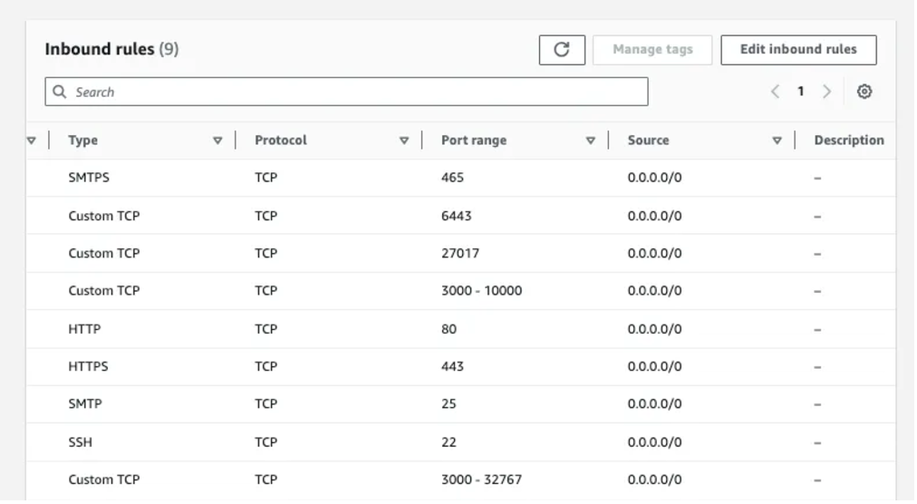
Repeat all above steps for other branches
Setting Up the Environment:
Launch an EC2 instance (Ubuntu, t2.large) and add inbound rules as shown in the image
Connect the EC2 instance with gitbash/mobaxterm/putty
sudo apt-get update

Slide 6
Create IAM User:
Create a user in AWS IAM with any name and attach the following policies:
AmazonEKS_CNI_Policy
AmazonEKSClusterPolicy
AmazonEC2FullAccess
AmazonEKSWorkerNodePolicy
AWSCloudFormationFullAccess
IAMFullAccess
We have to create an inline policy with the following content:
{
"Version": "2012-10-17",
"Statement": [
{
"Sid": "VisualEditor0",
"Effect": "Allow",
"Action": "eks:*",
"Resource": "*"
}
]
}

Slide 7
Create Security credentials for same user:
Under user → Security Credentials → Access keys → create access key
Install CLI Tools on EC2 Instance:
Create a script (Install_CLIs.sh) to install AWS CLI, kubectl, and eksctl:
Insert the following
Script in install_CLIs.sh
file .
# installing AWSCLI
curl "https://awscli.amazonaws.com/awscli-exe-linux-x86_64.zip" -o "awscliv2.zip"
sudo apt install unzip
unzip awscliv2.zip
sudo ./aws/install
# installing KUBECTL
curl -o kubectl https://amazon-eks.s3.us-west-2.amazonaws.com/1.19.6/2021-01-05/bin/linux/amd64/kubectl
chmod +x ./kubectl
sudo mv ./kubectl /usr/local/bin
kubectl version --short --client
# installing EKSCTL
curl --silent --location "https://github.com/weaveworks/eksctl/releases/latest/download/eksctl_$(uname -s)_amd64.tar.gz" | tar xz -C /tmp
sudo mv /tmp/eksctl /usr/local/bin
eksctl version
mkdir scripts
cd scripts
vi install_CLIs.sh

Slide 8
To install CLI give the below commands:
sudo chmod +x install_CLIs.sh
./install_CLIs.sh
Configure AWS CLI:
Create EKS Cluster:
eksctl create cluster --name=EKS-1 --region=us-east-1 --zones=us-east-1a,us-east-1b --without-nodegroup
Create IAM OIDC Provider:
We associate this with EKS cluster because the service account that we are going to create within the EKS cluster can understand IAM rules
eksctl utils associate-iam-oidc-provider --region us-east-1 --cluster EKS-1 --approve
AWS access key: paste the first access key
AWS secret access key: paste the first secret access key
Default region name: give region where ec2 instance created
Default output format [None]: enter

Slide 9
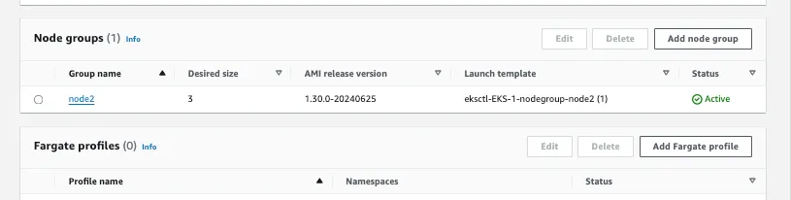
Create Node Group and Enable Auto Scaling:
eksctl create nodegroup --cluster=EKS-1 --region=us-east-1 --name=node2 --node-type=t3.medium --nodes=3 --nodes-min=2 --nodes-max=4 --node-volume-size=20 --ssh-access --ssh-public-key=mahesh-aws --managed --asg-access --external-dns-access --full-ecr-access --appmesh-access --alb-ingress-access
Setting Up Jenkins on EC2 Instance: Install Java and Jenkins
sudo apt install openjdk-17-jre-headless
sudo wget -O /usr/share/keyrings/jenkins-keyring.asc https://pkg.jenkins.io/debian-stable/jenkins.io-2023.key
echo "deb [signed-by=/usr/share/keyrings/jenkins-keyring.asc] https://pkg.jenkins.io/debian-stable binary/" | sudo tee /etc/apt/sources.list.d/jenkins.list > /dev/null
sudo apt-get update
sudo apt-get install jenkins -y

Slide 10
Access Jenkins:
Open Jenkins in your browser using <your-ec2-ip>:8080.
Install and Configure Plugins:
Manage Jenkins -> Plugins -> Available Plugins: Install Docker, Docker Pipeline, Kubernetes, Kubernetes CLI, Multibranch Scan Webhook Trigger.
Manage Jenkins -> Tools -> Docker Installations: Add Docker, Name: docker, enable automatic installation.
Install Docker on EC2 Instance:
sudo apt install docker.io –y
sudo chmod 777 /var/run/docker.sock
systemctl daemon-reload
systemctl restart jenkins
systemctl restart docker
Create credentials for accessing Docker Hub repository:
Manage Jenkins →Credentials → select global → add credentials: Username: mam***, Password: ****, ID: docker-cred, Description: docker-cred, Create

Slide 11
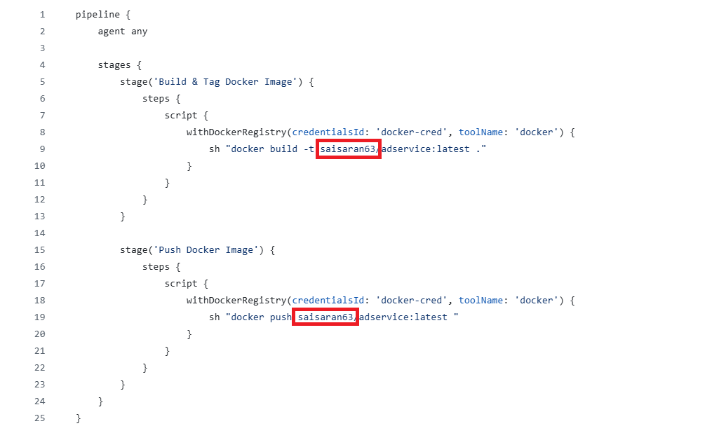
Update Jenkins file on every branch except main:
Change the docker hub user ID to your docker hub user ID.
Create Multibranch Pipeline:
Create a new job named MicroService-E-Commerce using the Multibranch Pipeline option.
Scan Multibranch Pipeline Triggers → select scan by webhook

Slide 12
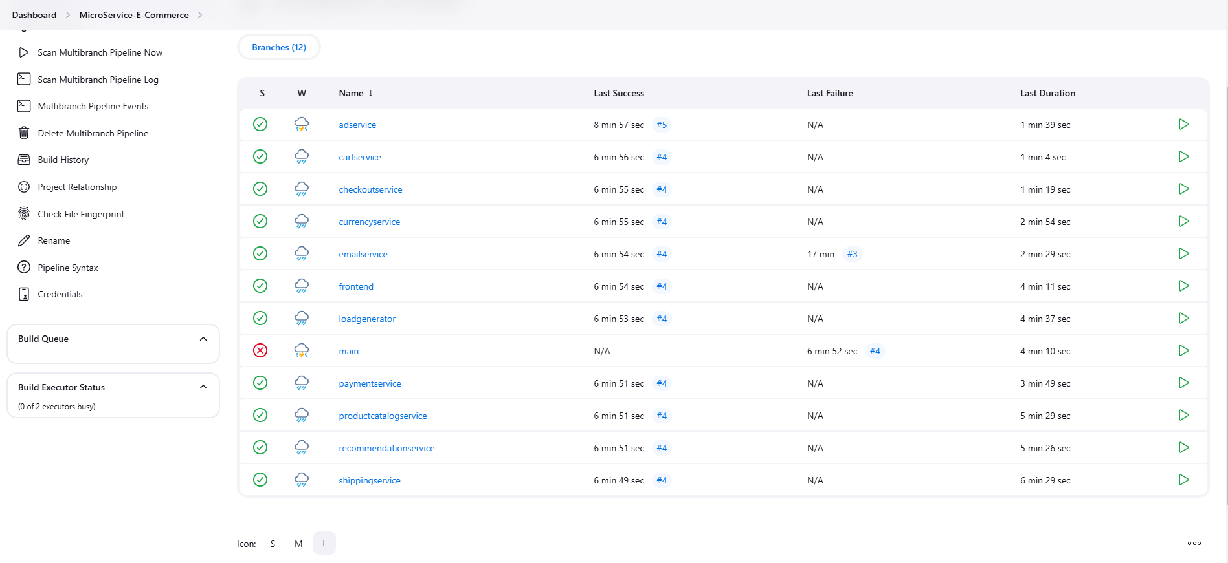
Trigger token: web
# JENKINS_URL/multibranch-webhook-trigger/invoke?token=[Trigger token]
Configure Webhook on GitHub:
Go to your GitHub repository settings -> Webhooks -> Add webhook.
Set the Payload URL to your Jenkins webhook URL and choose application/json as the content type.
All the pipelines will be trigged:

Slide 13
Continuous Deployment with Jenkins:
Create a namespace and a service account for Jenkins:
kubectl create namespace webapps
vi svc.yml
Give the following content on vi svc,yml:
apiVersion: v1
kind: ServiceAccount
metadata:
name: jenkins
namespace: webapps
kubectl apply -f svc.yml

Slide 14
Create a role and role binding:
vi role.yml
Add the following content:
apiVersion: rbac.authorization.k8s.io/v1
kind: Role
metadata:
name: app-role
namespace: webapps
rules:
- apiGroups:
# For core Kubernetes resources
- apps
- autoscaling
- batch
- extensions
- policy
- rbac.authorization.k8s.io
resources:
- pods
- componentstatuses
- configmaps
- daemonsets
- deployments
- events
- endpoints
- horizontalpodautoscalers
- ingress
- jobs
- limitranges
- namespaces
- nodes
- persistentvolumes
- persistentvolumeclaims
- resourcequotas
- replicasets
- replicationcontrollers
- serviceaccounts
- services
verbs:
- get
- list
- watch
- create
- update
- patch
- delete

Slide 15
kubectl apply -f role.yml
Bind the role to service account:
vi bind.yml
kubectl apply -f bind.yml
apiVersion: rbac.authorization.k8s.io/v1
kind: RoleBinding
metadata:
name: app-rolebinding
namespace: webapps
roleRef:
apiGroup: rbac.authorization.k8s.io
kind: Role
name: app-role
subjects:
- kind: ServiceAccount
name: jenkins
namespace: webapps

Slide 16
Generate and Use Service Account Token:
Create a secret for the service account:
we have to create token for the service account which will be used for authentication
vi secure.yml
Add the following content:
kubectl apply -f secure.yml
apiVersion: v1
kind: Secret
type: kubernetes.io/service-account-token
metadata:
name: mysecretname
namespace: webapps
annotations:
kubernetes.io/service-account.name: jenkins

Slide 17
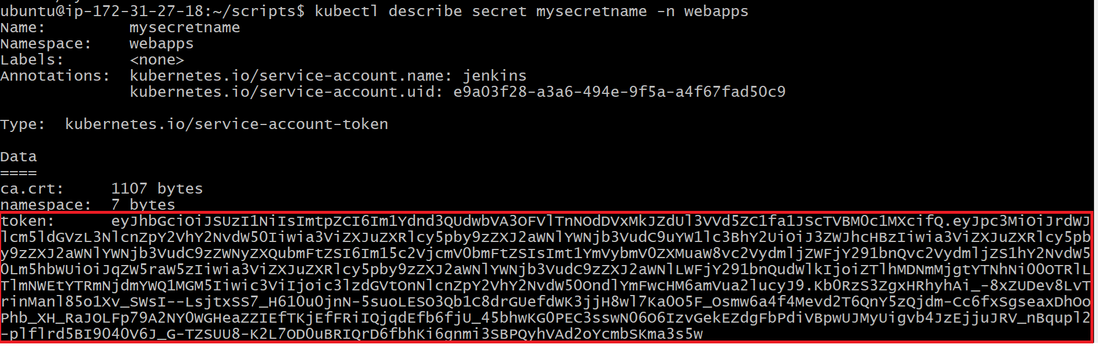
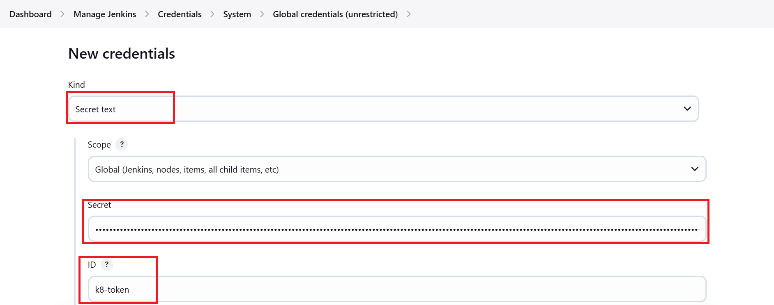
Get the token:
kubectl describe secret mysecretname -n webapps
Create Jenkins Token Credentials:
Manage Jenkins -> Credentials -> Global -> Add credentials: Kind: secret text, Secret: paste the token here, ID: k8-token

Slide 18
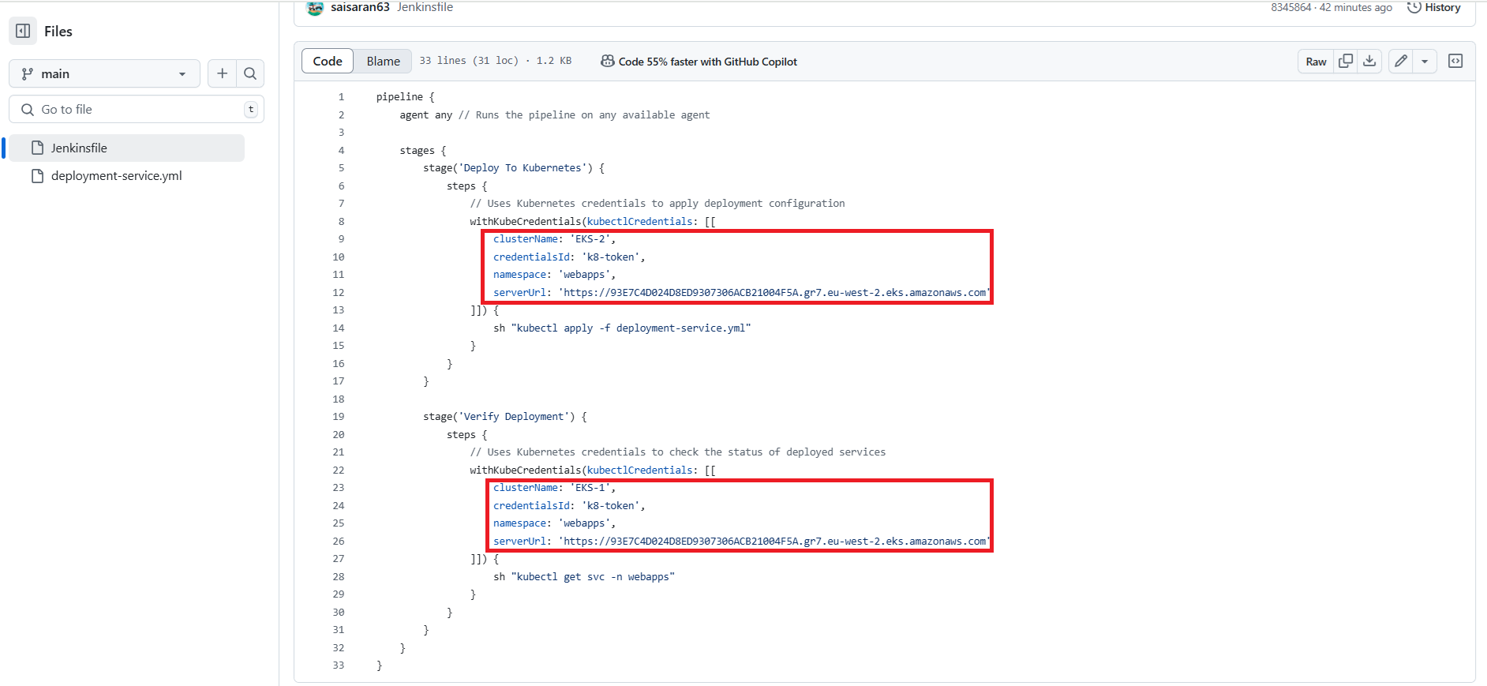
Update Jenkinsfile in main branch:
Update your Jenkinsfile with the KubeCredentials, cluster name, credentialsID: k8-token, Namespace: webapps, ServerURL: EKS APIs endpoint

Slide 19
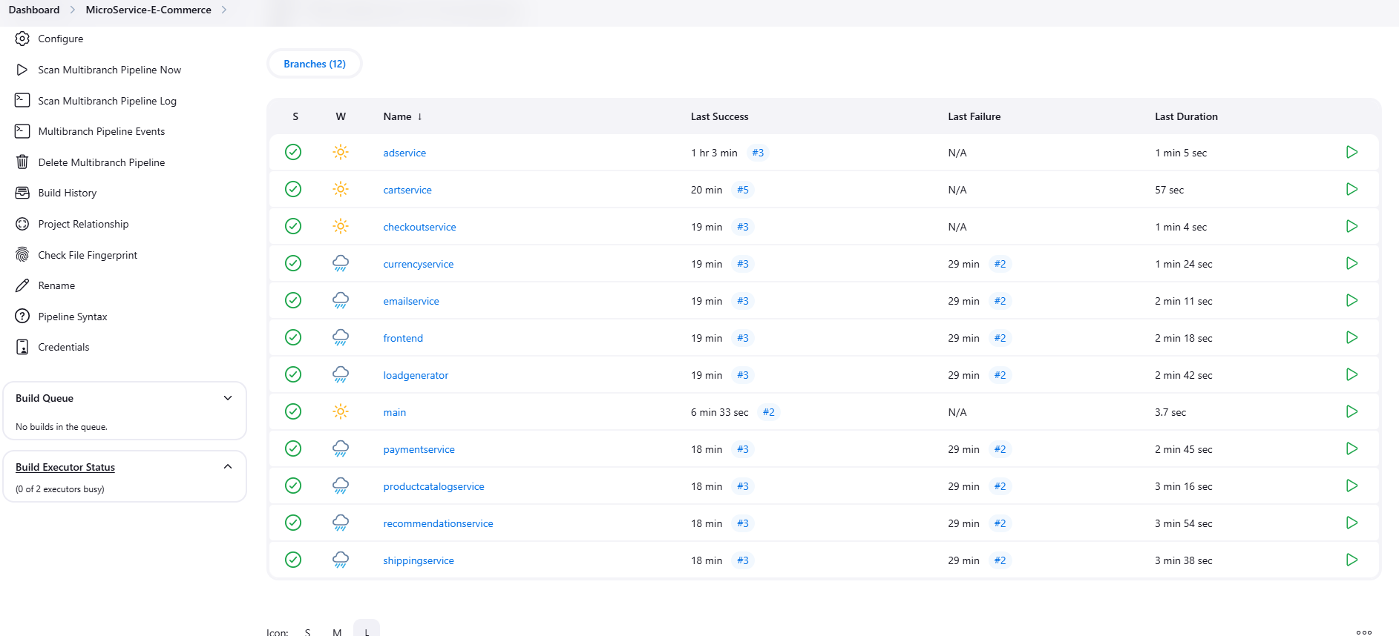
Main pipeline will be triggered now
To access the App
Go to Jenkins under main pipeline COPY the frontend-external IP and paste on the browser

Slide 20
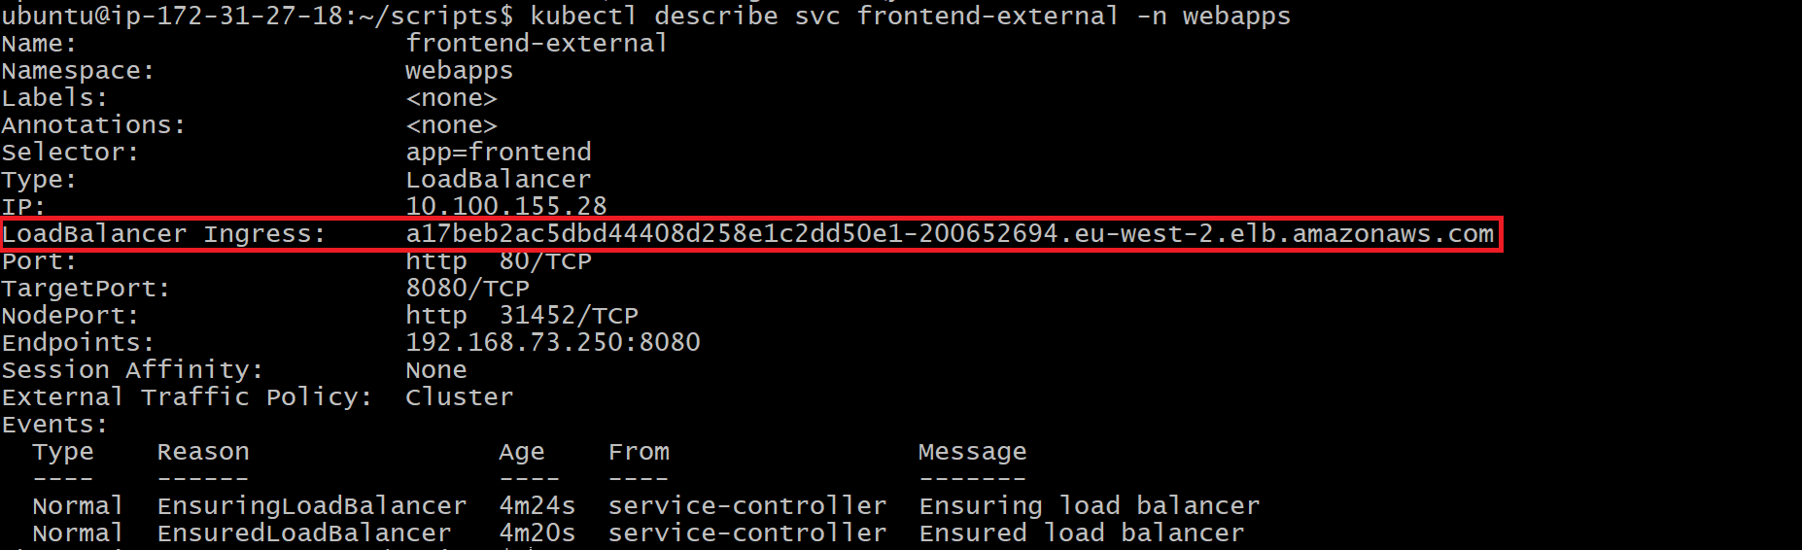
kubectl describe svc frontend-external -n webapps (To get an External IP)

Slide 21
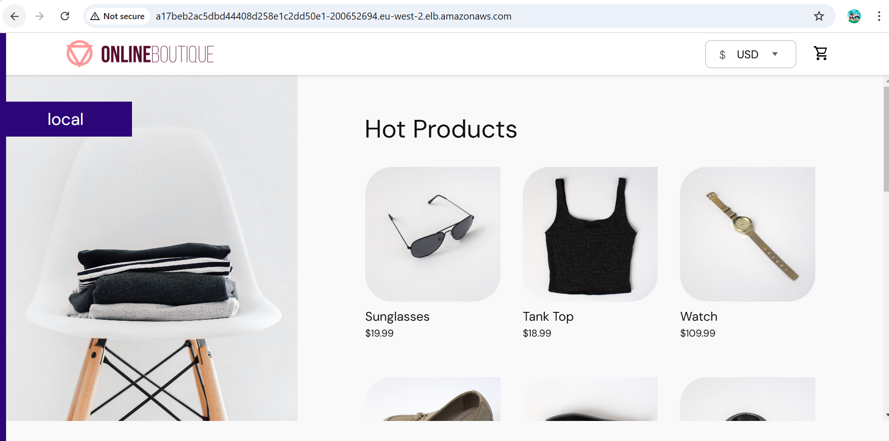
Copy and Paste the External IP in the chrome to get website

Slide 22


